Slide 1
Constructing the Cosmos Developing the Iconography of Astronomy in the Predynastic Period
Elizabeth Leaning
University of Auckland • Waipapa Taumata Rau
elea247@aucklanduni.ac.nz

Slide 2
Theories of State Formation
“Proto-State” Theory
(Köhler, 2010)
Monopoly Model
(Kemp, 2006)
Circumscription Theory
(Carneiro, 1970)
Syncopated progression of disparate tradition to political “unity”
Iconographic Toolkit
Agreement on a set of iconography in order to centralise and facilitate administration, craft production, trade, communication, and other key elements of the ancient Egyptian state.
Narmer Palette .
Cairo Museum JE 32169 .
Greywacke & Siltstone .
Hierakonpolis, Egypt .
Dynasty 1 (3100-3000 BC) .
63.5 x 42.0 x 1.5-4.0 cm .

Slide 3
Iconographic Toolkit
Agreement on a set of iconography in order to centralise and facilitate administration, craft production, trade, communication, and other key elements of the ancient Egyptian state.
This toolkit was a key part of state formation, allowing individual groups’ disparate and diverse traditions to coalesce into a common corpus of knowledge that aided in state unity.
Image by Andrew McCarthy
Astronomical tradition varies widely across geographically distributed populations. Stargazers at Heliopolis and Memphis at 30° North would observe the heliacal rising of Sopdet on a different day to stargazers at Elephantine at 24° North, or Abydos at 26° North.
Developing a universal astronomical iconography would have been a part of the state formation process in order to unify the traditions of Predynastic Egypt and create a mutually intelligible corpus of knowledge.

Slide 4
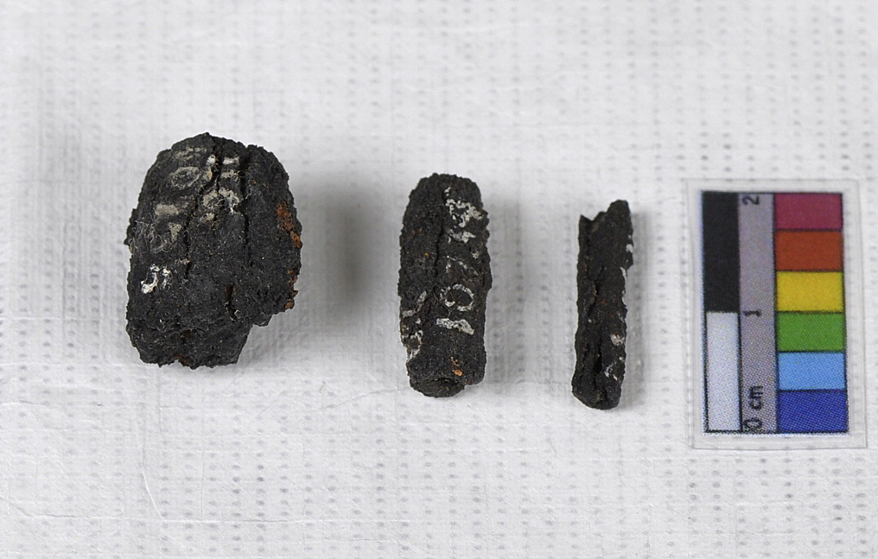
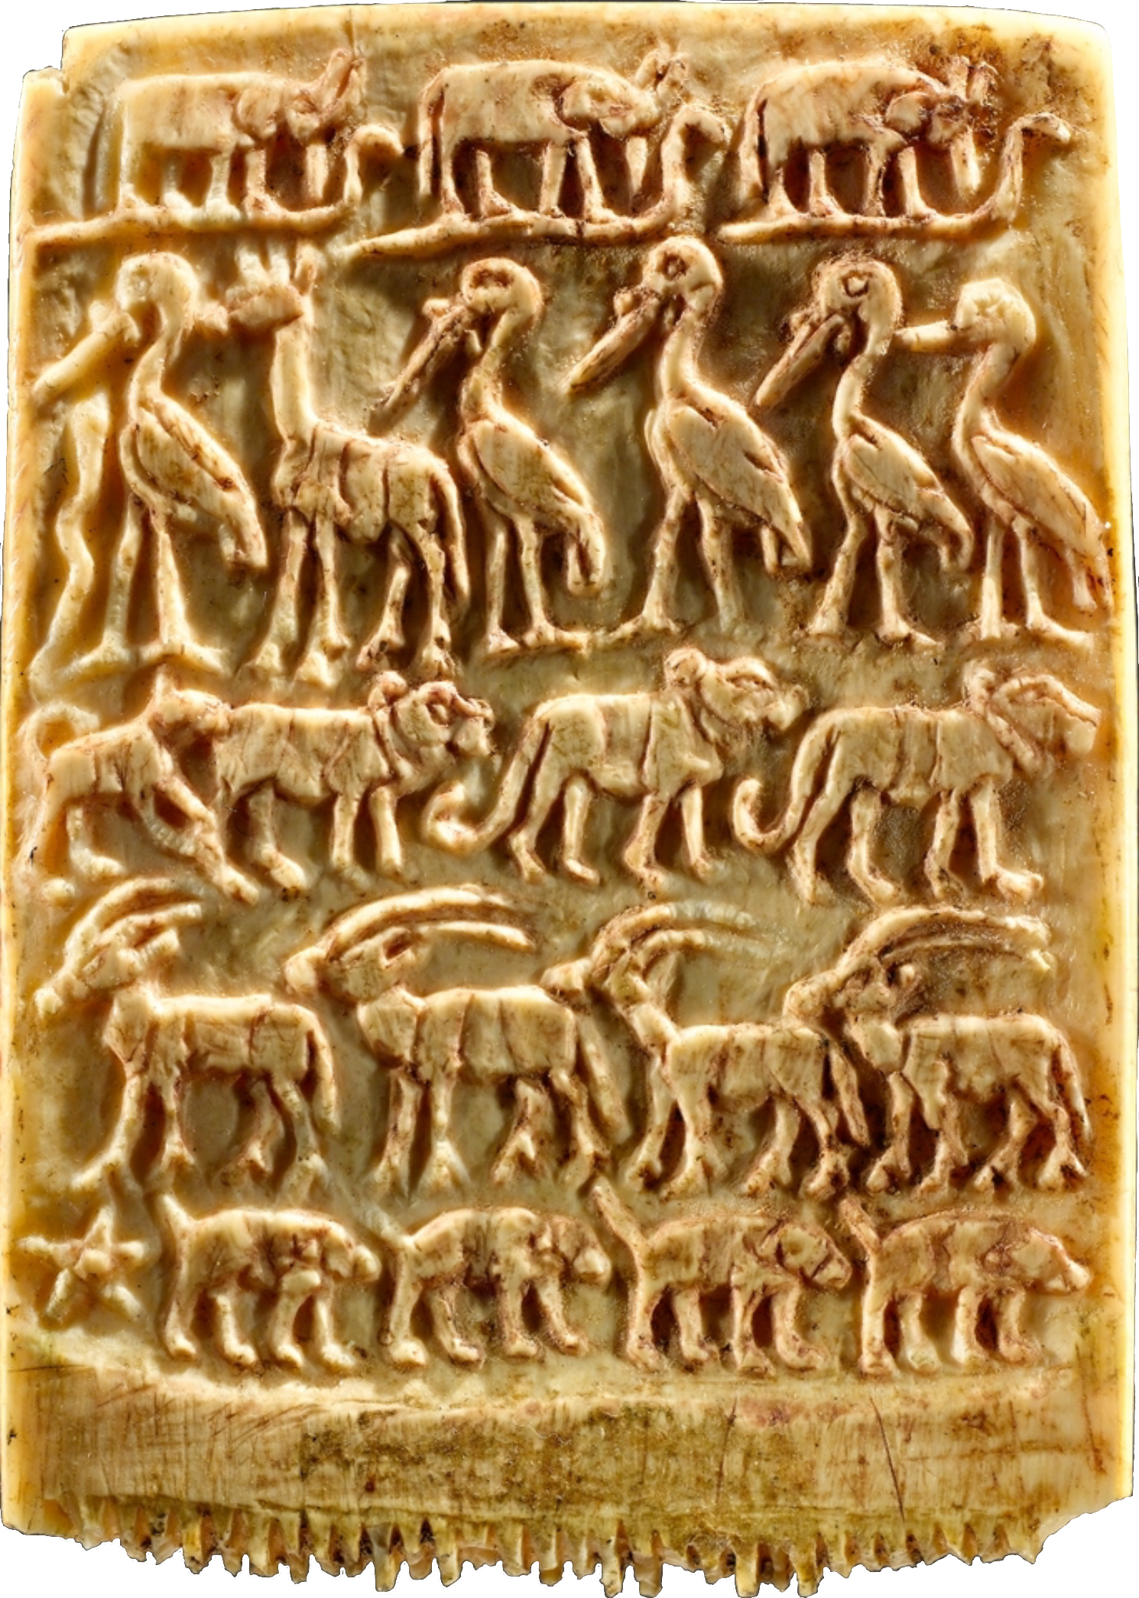
Iconographic Toolkit
Agreement on a set of iconography in order to centralise and facilitate administration, craft production, trade, communication, and other key elements of the ancient Egyptian state.
Three Gerzeh Iron Beads
Petrie Museum of Egyptian Archaeology
UC10738, UC10739, UC10740
Meteoric Iron
Gerzeh, Egypt
Naqada IIC–IIIA (3400-3100 BC)
Image by Gianluca Miniaci
Ritual Knife
Brooklyn Museum 09.889.118
Flint, Elephant Ivory
Abu Zaidan, Egypt
Naqada III (3300-3100 BC)
5.3 x 23.4 cm
The iconography of astronomy emerges at the same time as the rest of the iconographic toolkit, visible through three Predynastic artefacts.
Hair Comb Decorated with Rows of Wild Animals
MET 30.8.224
Ivory
Egypt
Late Naqada III (3200-3100 BC)
5.5 x 3.9 x 0.5 cm

Slide 5
The Gerzeh Predynastic Iron Beads represent the presence of meteors in ancient Egyptian thought, long before their appearance in literature.
A total of nine iron beads were excavated from Tombs 67 and 133 at Gerzeh’s predynastic cemetery, and dated to Naqada IIC or IIIA.
Testing by Rehren et al. identified their germanium, nickel and cobalt content as consistent with a meteoric origin.
Three Gerzeh Iron Beads
Petrie Museum of Egyptian Archaeology
UC10738, UC10739, UC10740
Meteoric Iron
Gerzeh, Egypt
Naqada IIC–IIIA (3400-3100 BC)
Image by Gianluca Miniaci
The iconography of astronomy emerges at the same time as the rest of the iconographic toolkit, visible through three Predynastic artefacts.

Slide 6
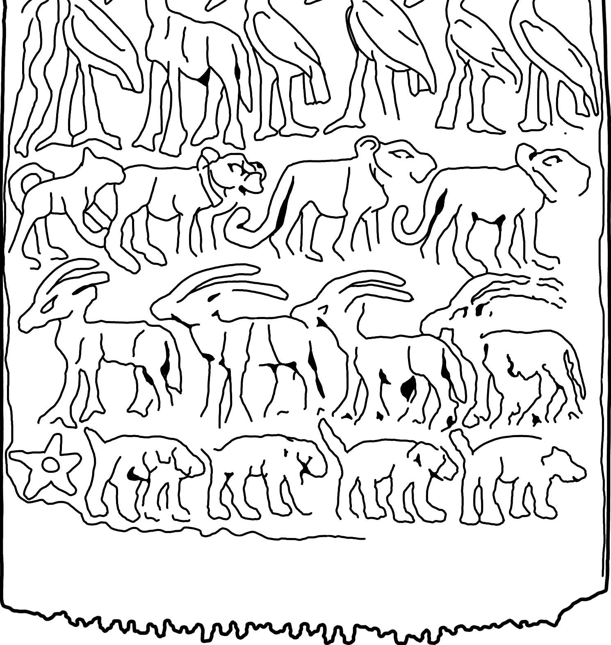
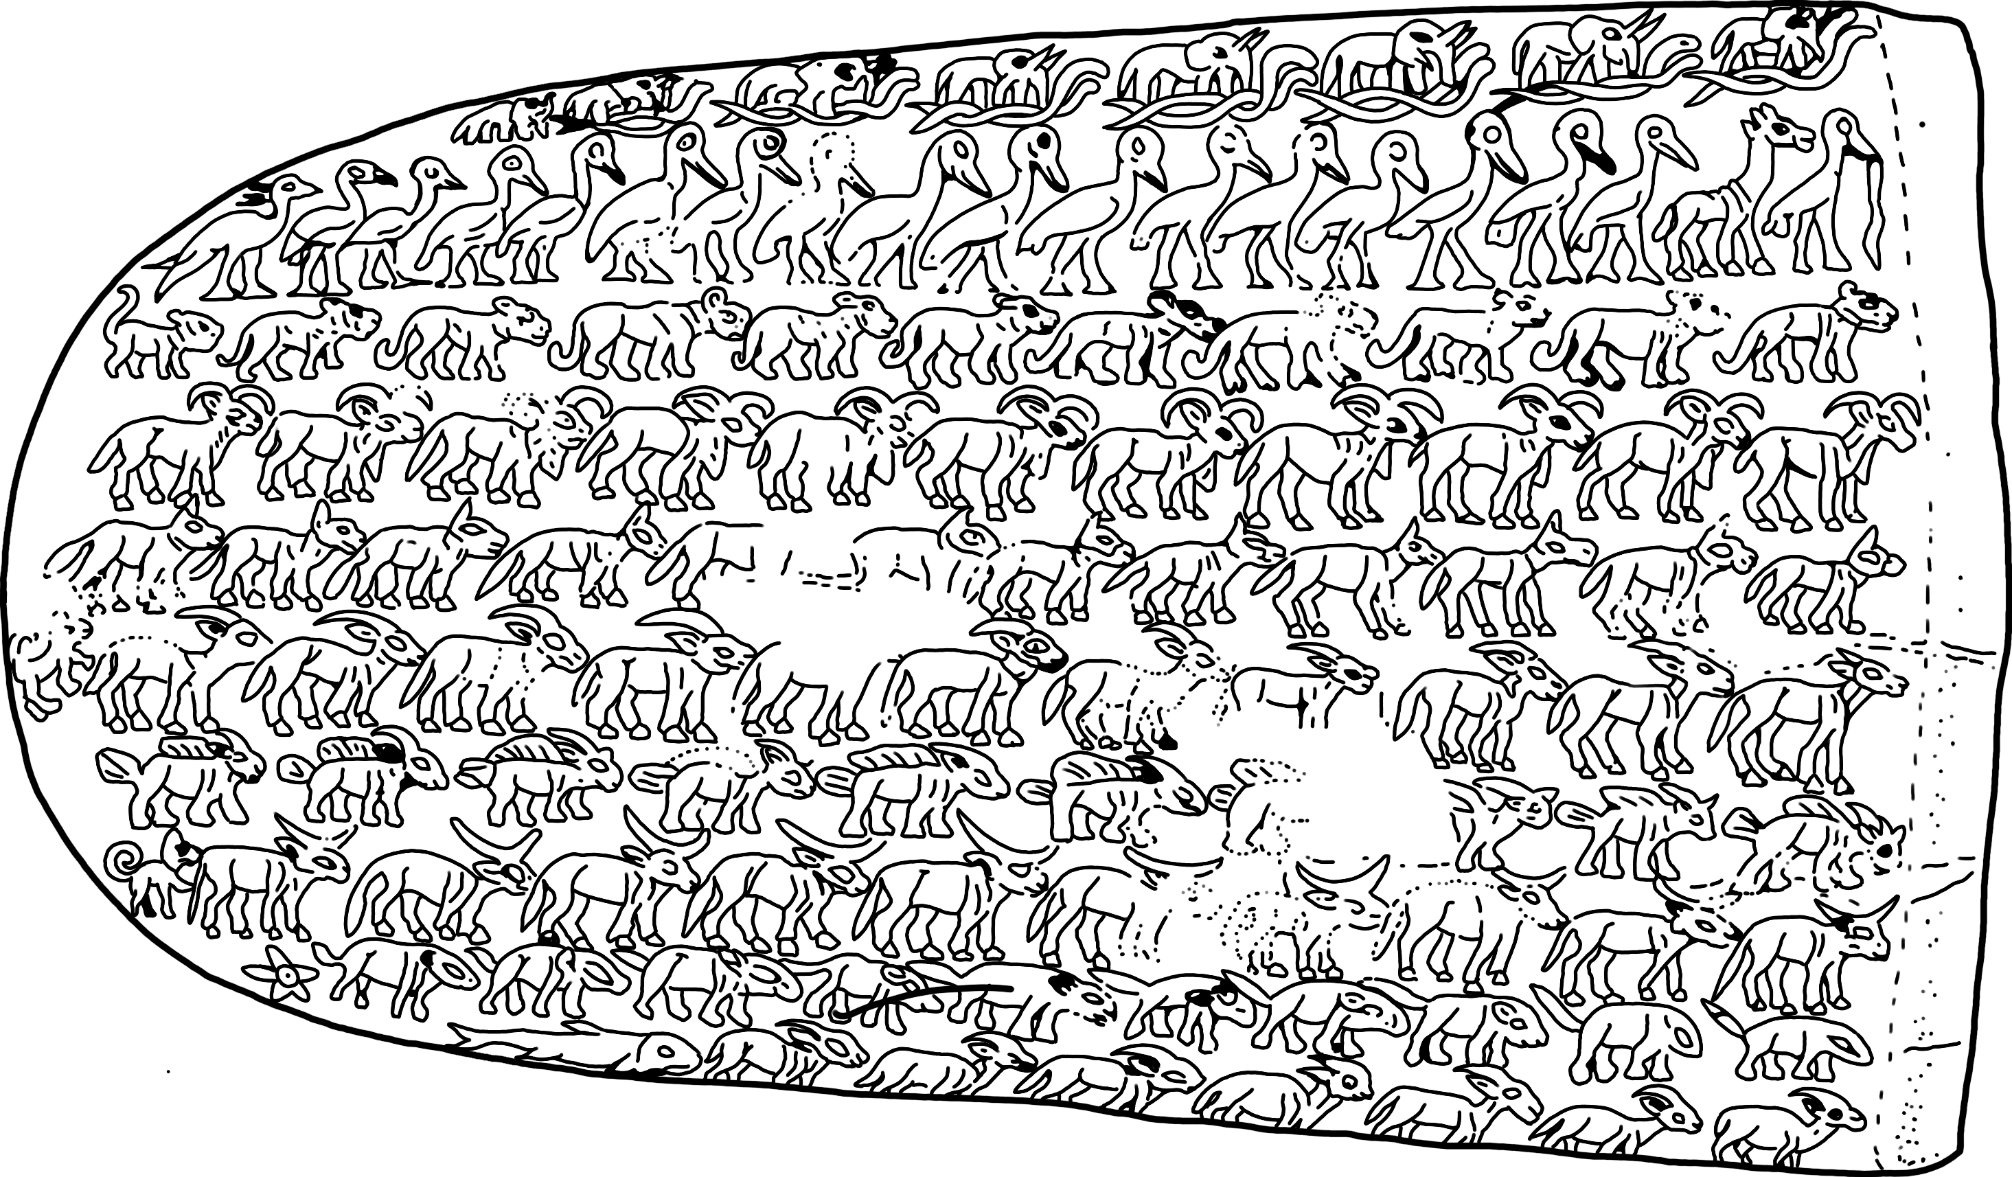
Both artefacts feature depictions of stars.
Appearing in the bottom left corners, the star is only visible on one side.
Hair Comb Decorated with Rows of Wild Animals
Ritual Knife
The iconography of astronomy emerges at the same time as the rest of the iconographic toolkit, visible through three Predynastic artefacts.

Slide 7
Both artefacts feature depictions of stars.
Appearing in the bottom left corners, the star is only visible on one side.
Traditionally, the animals on these artefacts have been the focus, as they are part of a wider stylistic corpus that includes objects such as the Pitt-Rivers Knife (EA68512). Thus, the meaning of the stars has been overlooked, when in fact the two could be interconnected.
The iconography of astronomy emerges at the same time as the rest of the iconographic toolkit, visible through three Predynastic artefacts.

Slide 8
Both artefacts feature depictions of stars.
Appearing in the bottom left corners, the star is only visible on one side.
Stars maintain their five-pointed iconography from their emergence in the Predynastic Period, through to the Ptolemaic Period. This remains consistent both in the hieroglyphic sign for star, and for their artistic representations.
Thus, it is impossible for images such as the Narmer Palette rosette to be a star, as they do not match the iconography that was definitely extant at the time.

Slide 9
Entheseal changes in both elite and non-elite burials show societal change was universal in the Predynastic Period – stellar iconography’s development was part of this change (Carballo-Pérez and Schrader, 2022).
The construction of ancient Egypt’s iconographical toolkit included engagement with celestial objects, both tangibly in the form of meteoric iron, and artistically in the form of the representation of stars. Celestial objects took on distinct meanings long before their first representations in literature.
The development of a centralized stellar iconography from disparate local traditions was a distinct part of Predynastic Egypt’s syncopated progression towards statehood.

Slide 10
WORKS CITED
Jared Carballo-Pérez and Sarah A. Schrader, “Embodied labors during the state formation of Egypt and Nubia (ca. 4800–1750 BCE): Elucidating transformations in behavioral patterns with entheseal changes,” International Journal of Osteoarchaeology 33, no. 3 (2022)
Robert Carneiro, “A Theory on the Origin of the State,” Science 169 (1970)
Barry Kemp, Ancient Egypt: Anatomy of a Civilisation (Oxford: Taylor & Francis Group, 2006)
E. Christiana Köhler, “The rise of the Egyptian state,” in Egypt Before the Pyramids: The Origins of Egyptian Civilization, ed. Emily Teeter (Chicago: Oriental Institute, University of Chicago, 2011)
Thilo Rehren, Tamás Belgya, Albert Jambon, György Káli, Zsolt Kasztovszky, Zoltán Kis, Imre Kovács, Boglárka Maróti, Marcos Martinón-Torres, Gianluca Miniaci, Vincent C. Pigott, Miljana Radivojević, László Rosta, László Szentmiklósi, Zoltán Szőkefalvi-Nagy, “5,000 years old Egyptian iron beads made from hammered meteoritic iron”, Journal of Archaeological Science, 40, no. 12 (2013)
Ann Macy Roth, “Objects, Animals, Humans, and Hybrids: The Evolution of Early Egyptian Representations of the Divine,” in Dawn of Egyptian Art, ed. Diana Craig Patch (New York: The Metropolitan Museum of Art, 2011)
NGĀ MIHI
THANK YOU

